Slide 1


PSIFI - 3rd Delivery
Jose Carlos Pacheco Sanchez - A01702828
Manuel Yafté Gallegos López - A01702980
Hugo David Franco Ávila - A01654856
Valeria Nicole Barra Maldonado - A01653899

Slide 2
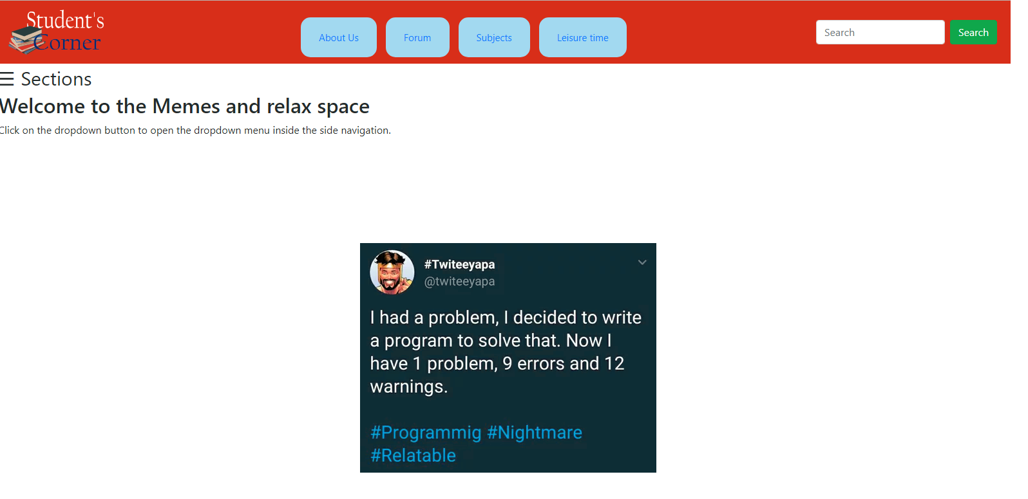
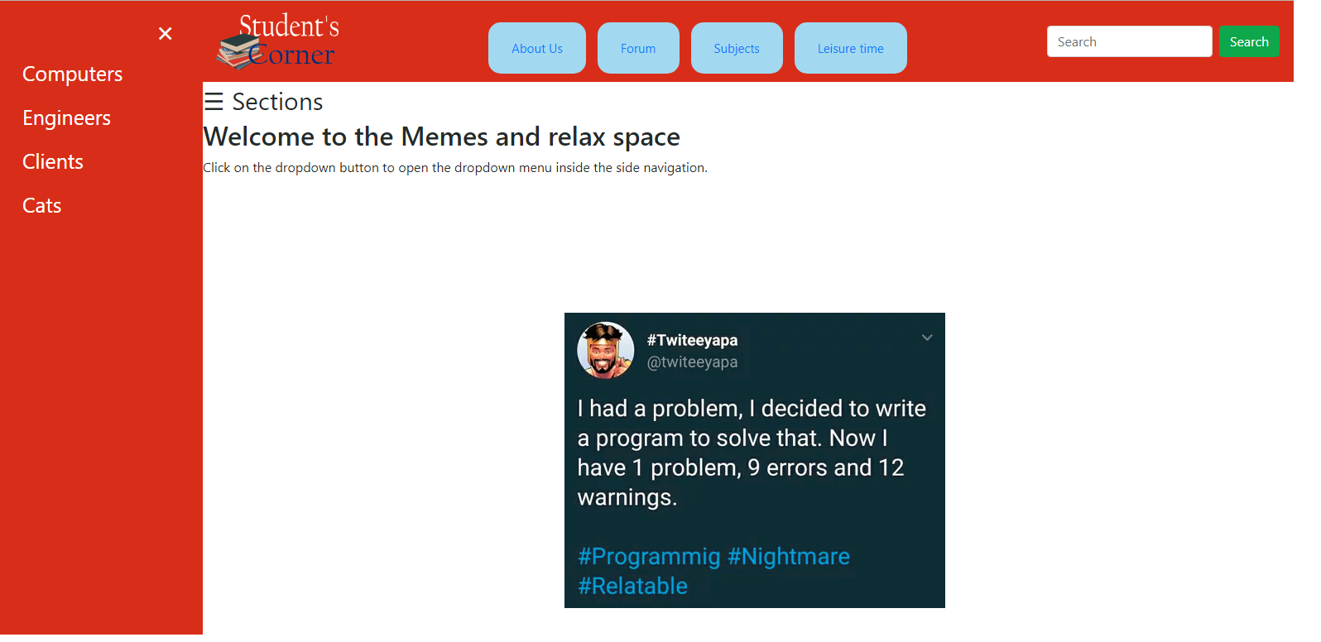
Interactive system

Slide 3
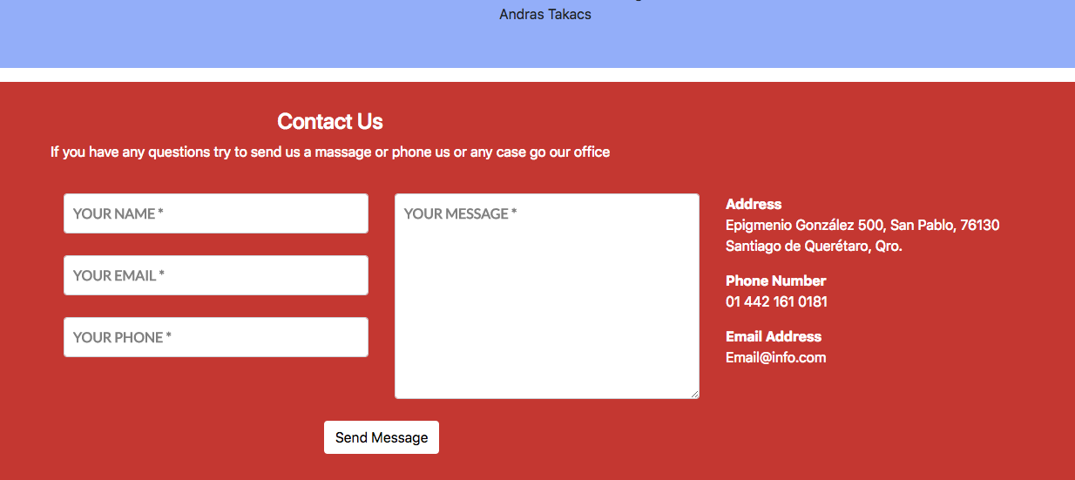

Slide 4
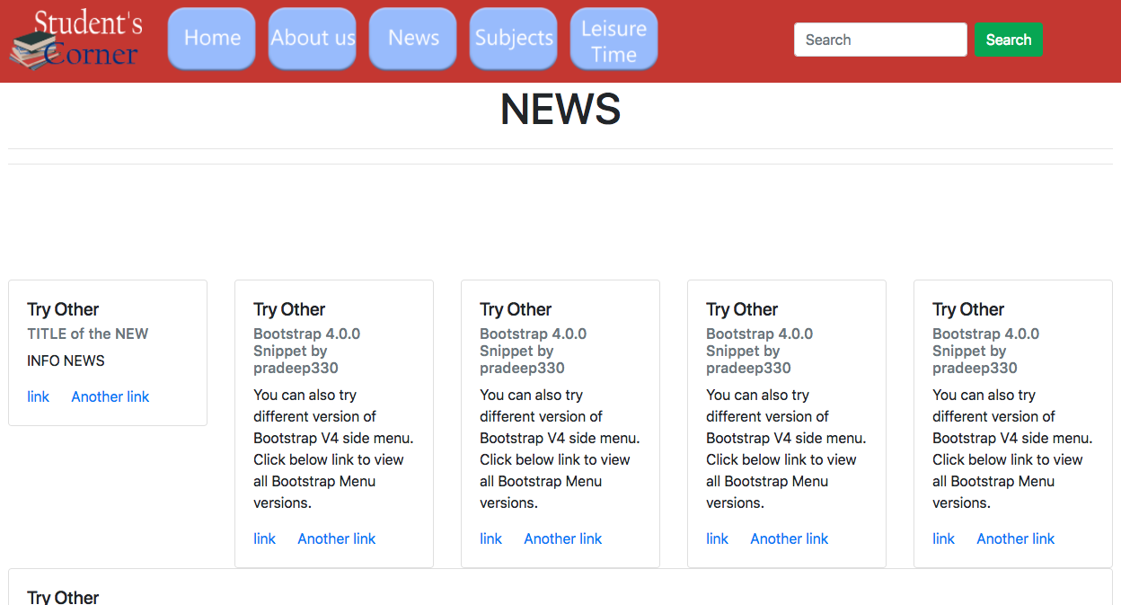
Forum → NEWS

Slide 5
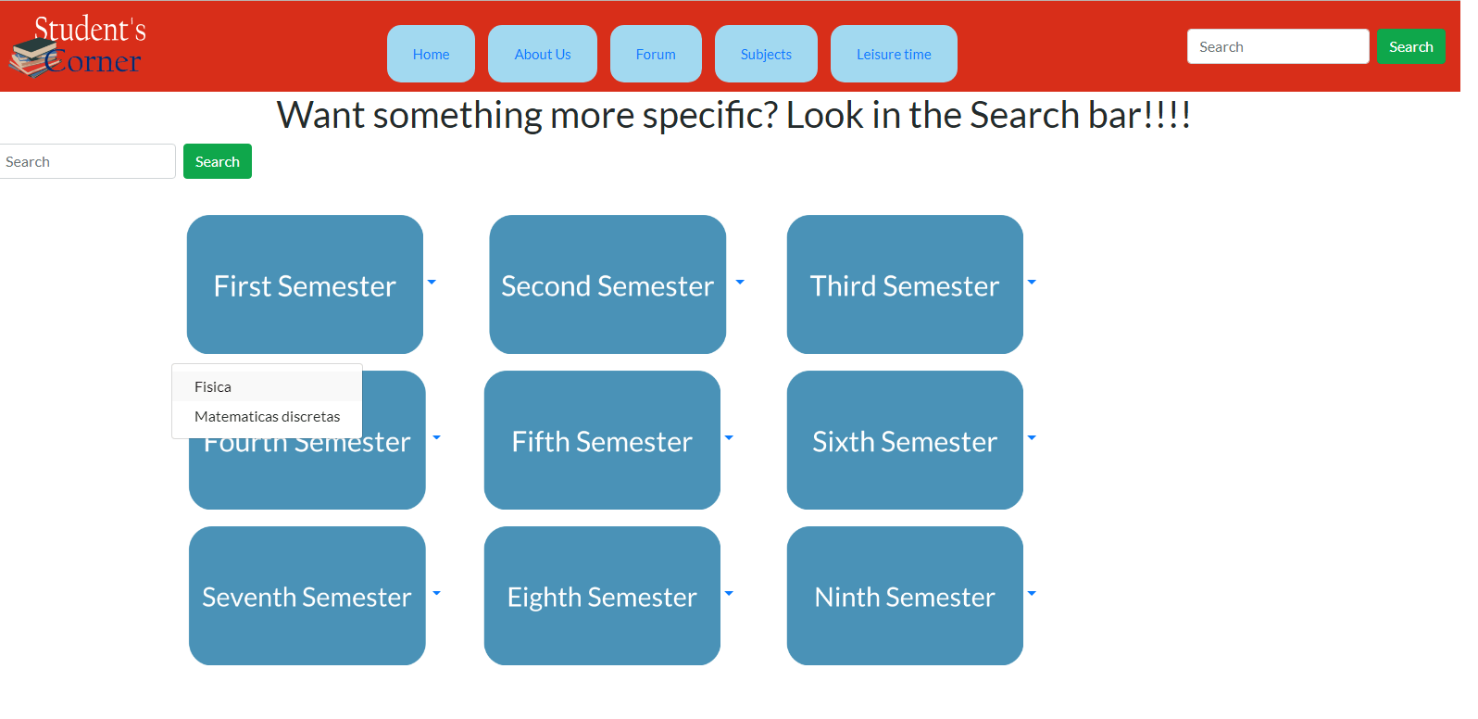
Including usability

Slide 6
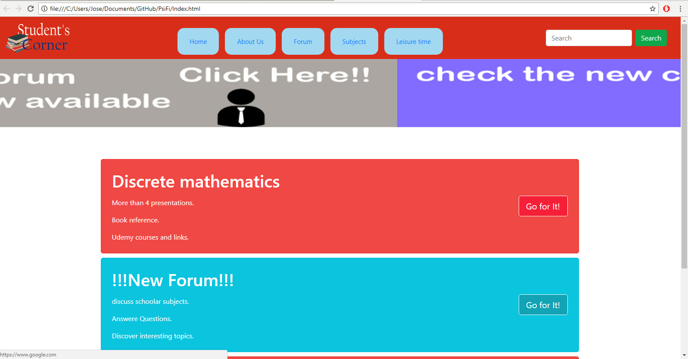
Design and functionality

Slide 7

Progress with the implementation
We have finished the main site and are finishing adding information to smaller pages

Slide 8

Interview and survey
What do you think of the logo?
Is the text readable and understandable?
Were the buttons too close together?

Slide 9

Usability testing
Did any of the pages you saw have blurry text or images?
Did the images load properly on the site?
Were the names of the sections related to what you saw on screen after you clicked them?
Did you find the Sticky Bar helpful?

Slide 10

Functionality
Did every button redirect you to the page it said it would?
Did every link work properly?
Does the sticky middle bar moved as you scrolled within the page?
Do dropdown menus work as they should?

Slide 11
Was the carrousel in the main page refreshing its image every 5 seconds?
Was there anything you thought affected your ability to use the page?

Slide 12

Model questionnaires for evaluating UI.
QUESTIONS
it's easy to use?
it's easy to find things?
The colors are friendly?
Would you use it?
YES
NO

Slide 13
Reacting to feedback
We are working to get our page to be fully responsive
Links and presentations are going to be opened in a different window
Define functionality to search bar
Improve image quality
Add more information about our website, how does it work, what is our objective, etc.
Home page with more relevant information
Improve navigability

